Slide 1
Analysis of Salary Data
Data Scientist: Ashley Donohoe
© 2024 Udacity.

Slide 2
Agenda
Findings of linear regression modeling with tech salary data
Data Description
Regression Results
Interpretation and Next Steps

Slide 3
Data Description (1 of 2)
This dataset originally included 375 employees.
There was missing data for two employees, which were dropped since they accounted for only a tiny portion, leaving 373 employees.
Salaries for the 373 employees ranged from $350 to $250,000, with the average salary at $100,577 and the median at $95,000. The histogram for the salary data is right-skewed, where most employee salaries range from around $40,000 to $150,000.
The following features appear to be correlated with salary:
Education level: Higher education levels are correlated with higher average salaries: bachelor’s ($74,756), master’s ($129,796), and Ph.D. ($157,843).
Gender: Males earn a higher average salary ($103,868) than females ($97,011), a difference of $6,857.
Years of experience: Average salaries tend to increase year-over-year for professionals with 0 to 25 years of experience; this is also confirmed with the “r” value of 0.93.
Job title: Having a manager, senior, or director title is correlated with higher salaries.

Slide 4
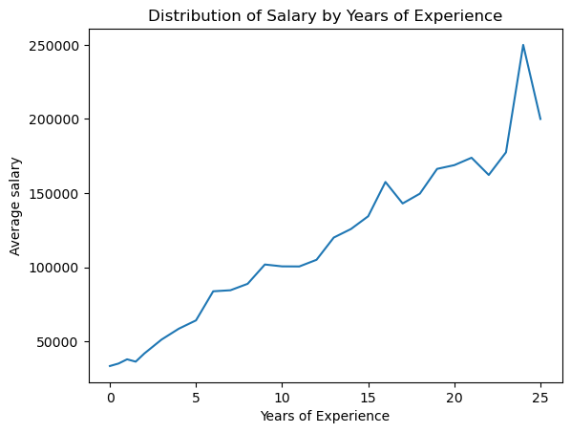
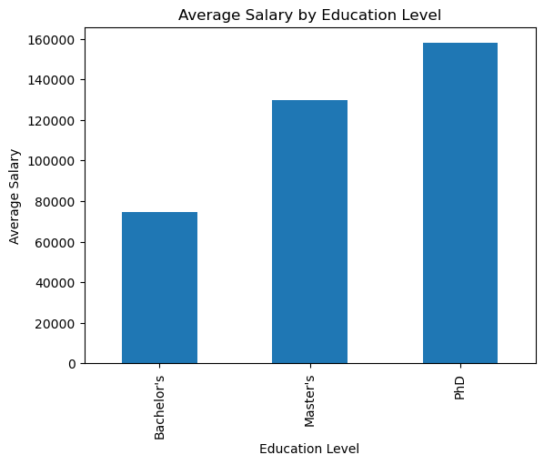
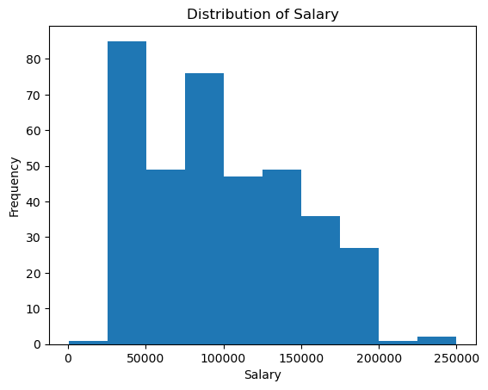
Data Description (2 of 2)
Sample of supporting charts

Slide 5
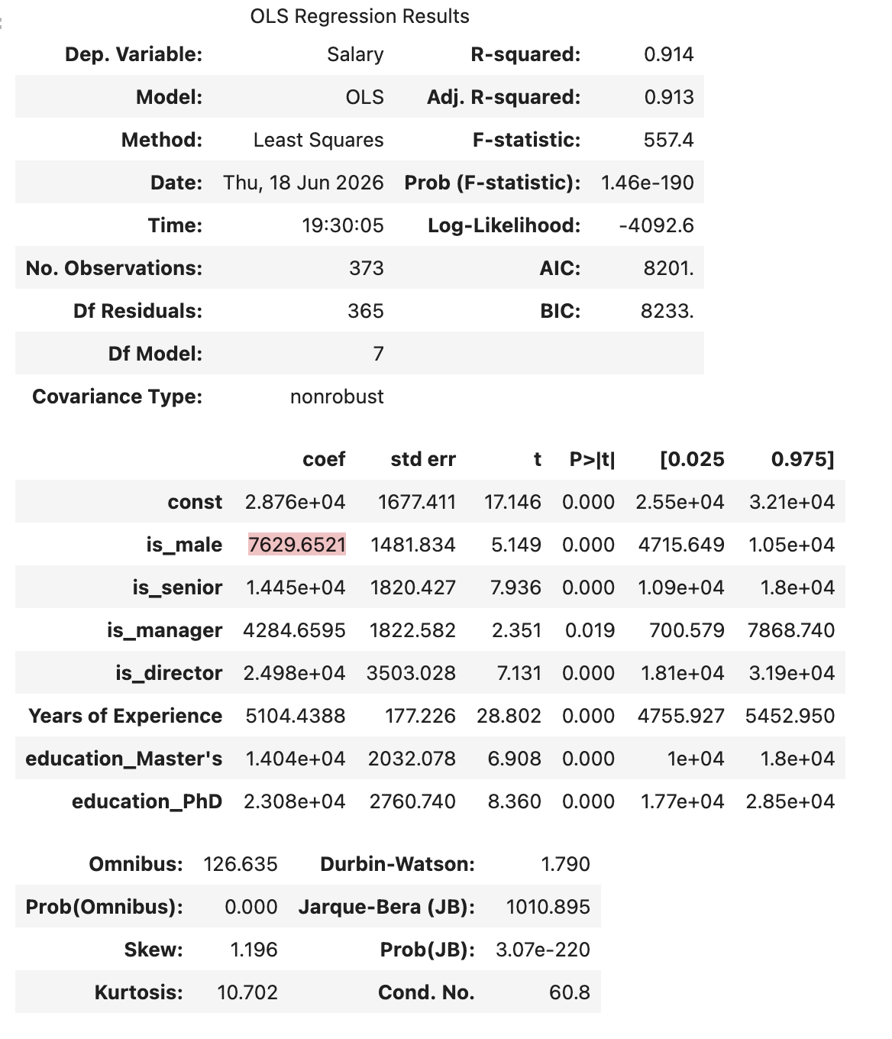
Regression Results (1 of 3)
Final model output:

Slide 6
Regression Results (2 of 3)
The original model used 10 predictors, with resulting values of 0.915 for R-squared and 0.913 for adjusted R-squared. The final model used 7 predictors with similar resulting values of 0.914 for R-squared and 0.913 for adjusted R-squared.
These variables were found statistically significant in their relationship with salary, with p<0.05. Their resulting values in the final model are as follows:
is_male (p<0.001, coef=+$7,630)
is_senior (p<0.001, coef=+$14,450)
is_manager (p=0.019, coef=+$4,285)
is_director (p<0.001, coef=+$24,980)
Years of Experience (p<0.001, coef=+$5,104)
education_Master’s (p<0.001, coef=+$14,040)
education_PhD (p<0.001, coef=+$23,080)
The following variables were found to not be statistically significant based on the full model results and were removed when creating the final model:
is_junior (p=0.068, coef=-$4,493)
is_analyst (p=0.933, coef=-$176)
is_engineer (p=0.508, coef=+$2,363)

Slide 7
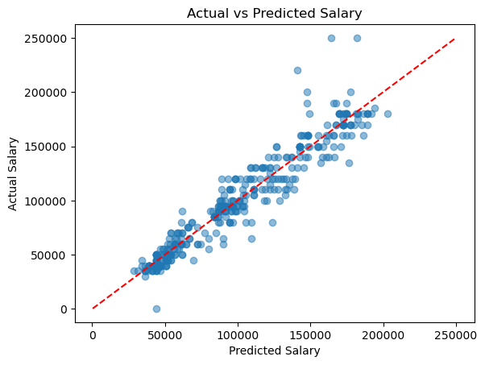
Regression Results (3 of 3)
The model appears to fit the data relatively well based on the R-squared and adjusted R-squared values.
We can conclude that the model accounts for around 91% of the variance in salary.
A scatterplot of the actual versus predicted salary data confirms a good fit, despite some outliers, especially for higher salaries.

Slide 8
Interpretation and Next Steps
Variable 1: Senior title (compared to someone with no other title indications)
Given that all other variables remain constant, salary is expected to increase by approximately $14,450 for an employee with a senior title.
I’m 95% confident that the difference in salary will be around $10,900 to $18,000.
Variable 2: Years of experience
With each additional year of experience, salary is expected to increase by approximately $5,104.
I’m 95% confident the salary will increase by approximately $4,756 and $5,453 for each additional year of experience.
Potential next steps:
Consider further cleaning the data to address outliers that can skew the model.
Add more features to see whether they might impact salary, such as the employee’s location, age, company size, and race.
Experiment with machine learning and scikit-learn for predicting new salary data.

